Slide 1

Statistics from
THE ARBITRATION INSTITUTE
OF THE STOCKHOLM CHAMBER OF COMMERCE

Slide 2

Introduction
The Arbitration Institute of the Stockholm Chamber of Commerce (“SCC”) was established in 1917 and is an independent part of the Stockholm Chamber of Commerce. In the 1970's the SCC was recognized as a neutral centre for the resolution of East-West trade disputes by the United States and the Soviet Union, and at the same time, China also recognized the SCC as a forum for resolving international disputes. The SCC has, since then, expanded its services in international commercial arbitration and is today one of the world’s leading forums for dispute resolution.
The SCC procedural rules are modern and flexible and give the parties and the arbitrators means to form effective procedures adapted for the individual case. The SCC rules are in line with the best practices in international arbitration, and in addition to the SCC rules, the SCC has also developed Mediation Rules and Procedures and Services under the UNCITRAL Arbitration Rules.
Our law firm, MORE Evander, is frequently assigned to represent our clients in commercial disputes, both in district court and in arbitration proceedings before the SCC. Our lawyers are skilled and have extensive experience when it comes to litigation under the SCC procedural rules.
This presentation summarise some statistics published by SCC regarding the arbitral cases held in Sweden under the SCC rules during 2023.
Should you have any questions about arbitral proceedings in Sweden, please contact Johannes Marszalek (johannes.marszalek@amelegal.se) partner at MORE Evander.

Slide 3

Caseload and seat of arbitration
With a total of 175 cases, the majority of them (97 cases) were international disputes and the rest (78 cases) were Swedish disputes (involved only Swedish parties). Most of them had Stockholm (135 cases) as their seat of arbitration.
Top 3 seats of arbitration:
Göteborg, 13
Malmö, 5
Stockholm, 135

Slide 4

Applicable rules
Of the caseload, 55 % (96 cases) were registered under the SCC Arbitration Rules
38 % (67 cases) were registered under the SCC Rules for Expedited Arbitrations
The arbitrations were registrered under different regulations and rules
Apart from these two major regulations, other applicable rules were:
Ad hoc or services, 5
Emergency Arbitration, 4
UNCITRAL Rules, 2
SCC Express, 1

Slide 5
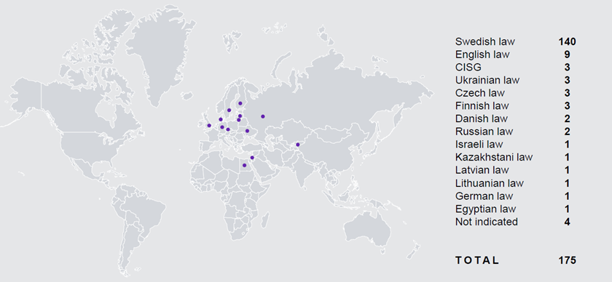

Nationality of the parties and applicable law
Parties from 42 different countries appeared in disputes before the SCC in 2023
The most frequent were Sweden (251), Thailand (28) and Denmark (18)

Slide 6

Disputed agreements
Other disputed agreements were:
Credit/loan agreement, 22
Corporate agreement, 13
Construction agreement, 11
Cooperation agreement, 11
Employment contract, 6
Intellectual property agreement, 4
Licence agreement, 3
Bilateral investment treaty, 2
Settlement agreement, 1
Top 3 disputed agreements:
Service agreement, 35
Business acquisitions, 35
Delivery agreement, 32

Slide 7

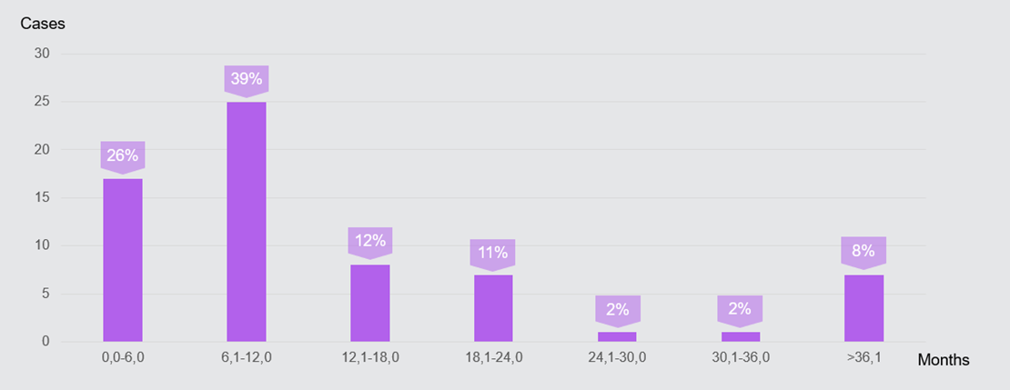
Time for rendering award
26 % of the awards rendered under the SCC Arbitration Rules in 2023, were rendered within 6 months
39 % of the awards were rendered between 6 to 12 months

Slide 8
Conclusion
There are many advantages to choosing Sweden and the SCC as the place for arbitral proceedings. It is one of the world's leading arbitration institutes with fast proceedings and excellent procedures when it comes to handling international disputes. The SCC procedural rules are in line with the best practices in international arbitration and our lawyers have extensive experience litigating under them. Should you have any questions about arbitral proceedings in Sweden, please contact Johannes Marszalek (johannes.marszalek@amelegal.se) partner at MORE Evander.

